Slide 1
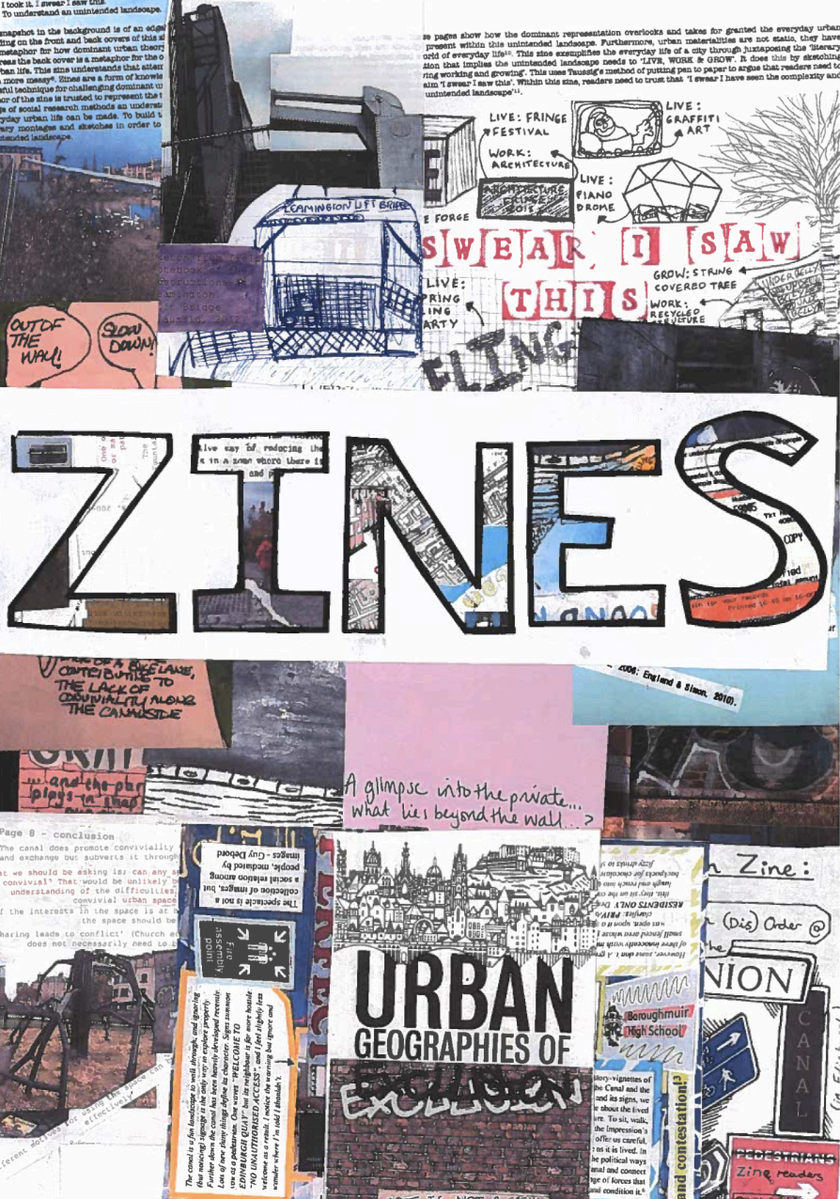
Zines
A presentation by Jacqueline Hennecke
Jacqueline Hennecke

Slide 2
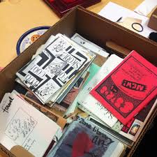
Zines are: A small circulation, self-published

Slide 3
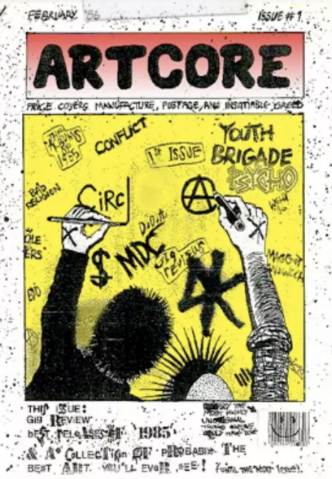
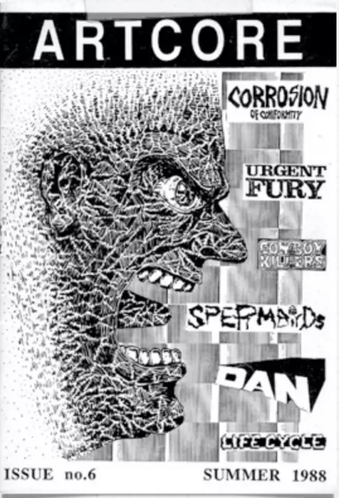
Written, designed,and published by creators

Slide 4
Zines are…
Specific
Personal
Political
Disruptive

Slide 5
Zines may be…
Fan art
Poetry
Political
Diaries

Slide 6
With the advent of the copy machine, zines became a format of personal expression and communication in the late 1960s
HISTORY

Slide 7
Zines are made…
By hand
By copy/by printer
Virtually

Slide 8
ZINES MADE BY HAND

Slide 9
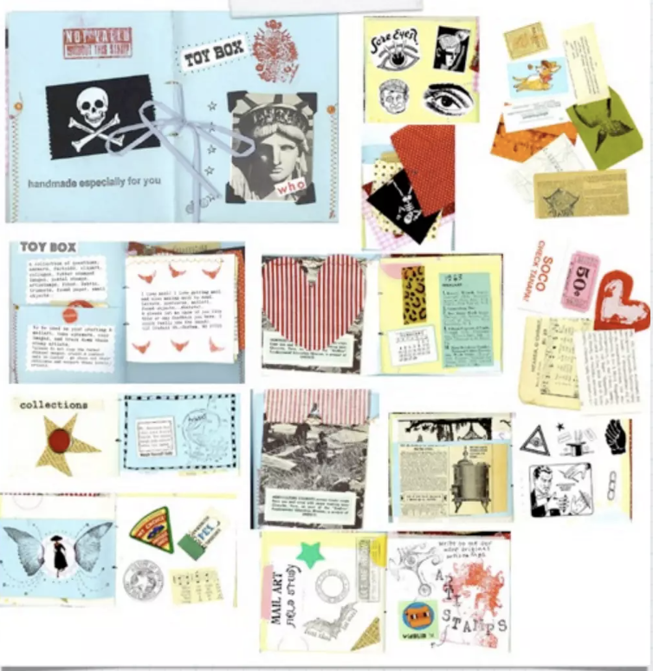
Main functions:
Really, zines can cover just about anything: art, politics, sci-fi, music, personal journals, etc.
With the advent of the internet, zines have been considered merely artist books.

Slide 10

Main functions:
Still, avid zine-makers, believe that the internet cannot compare to physically holding the “object” in your hands

Slide 11
ZINES MADE BY MACHINE

Slide 12
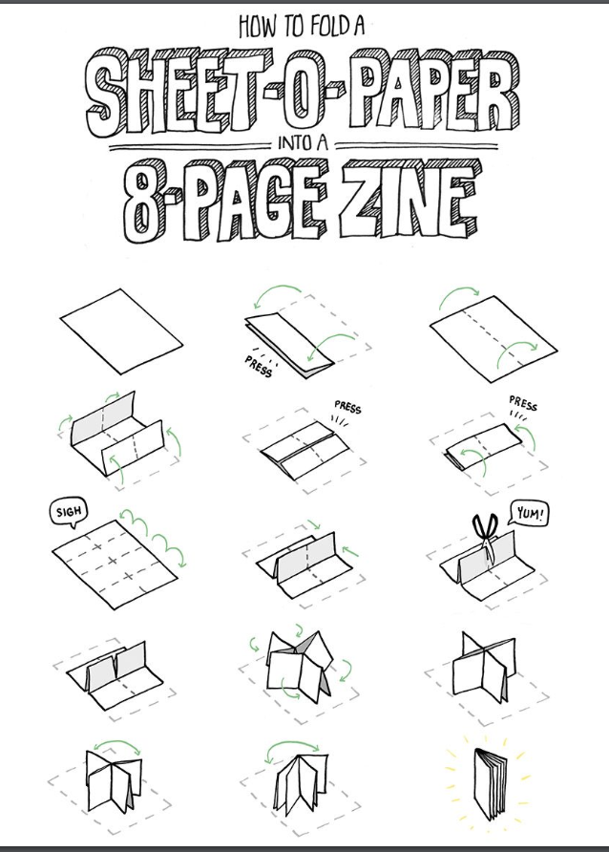

Slide 13
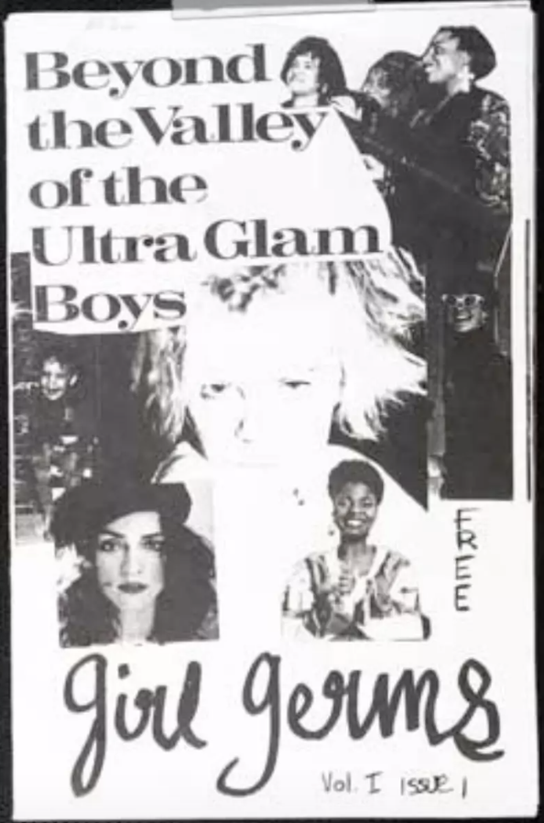
Subversion
Zines are mostly free, allowing unfettered access to content unsuitable for mainstream

Slide 14

Prototype
Some popular magazines started as zines, made in garages and basements

Slide 15
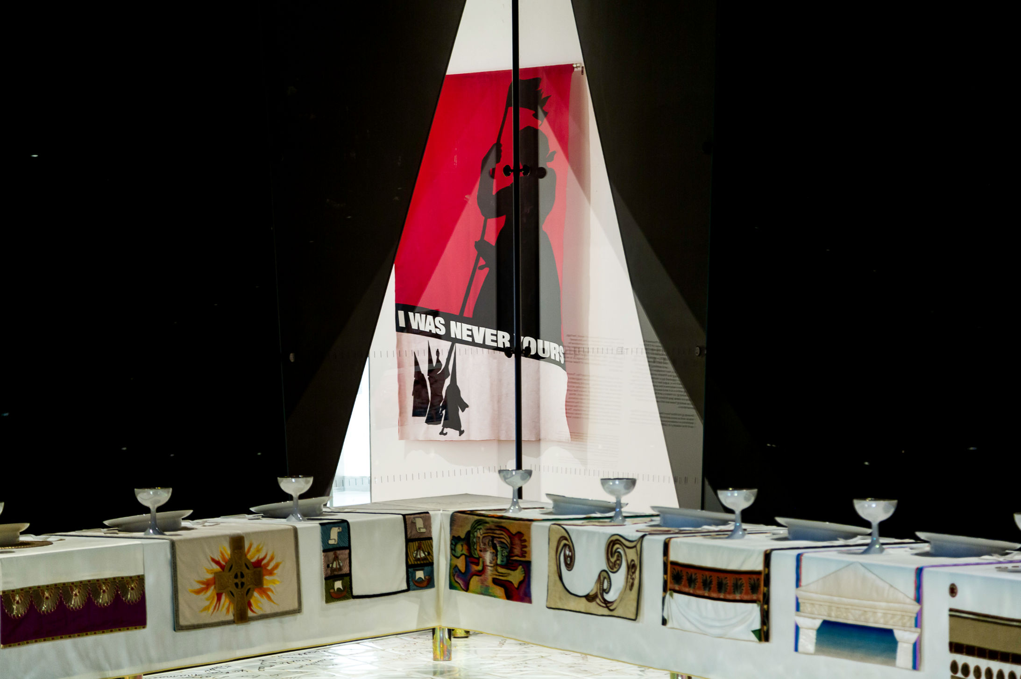
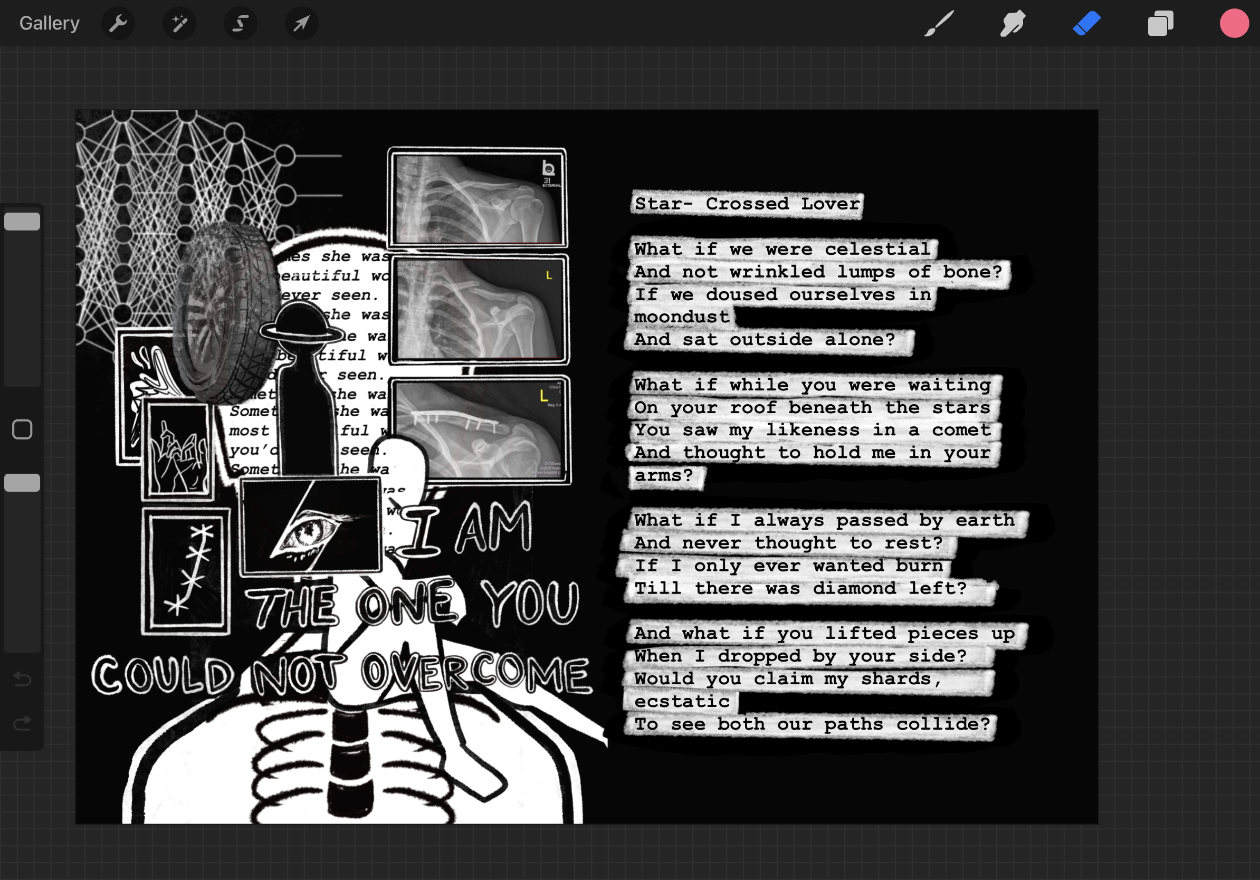
Notes:
If you’ve ever studied protest art, you might of heard of guerrilla girls or even Elektra kb.
Making art out of non-conventional (non-masculine materials)

Slide 16
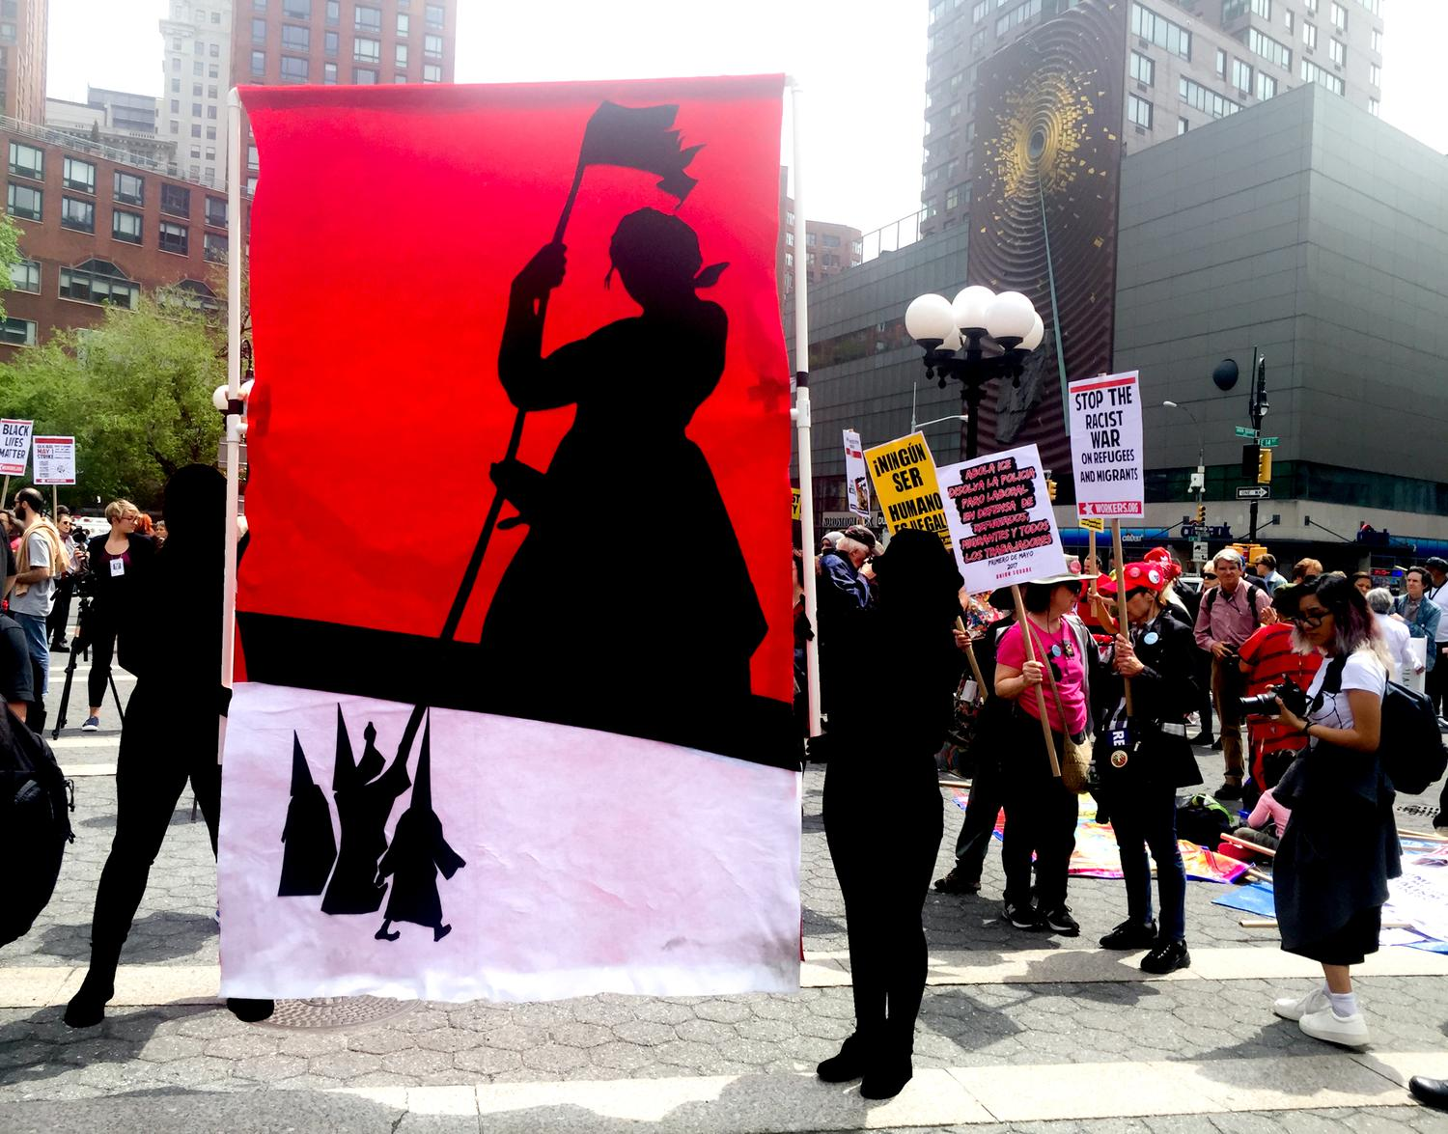
Elektra KB PROTEST SIGN III
Notes:
Zines may be one of many ways art has a very tangible impact

Slide 17
The Things We Would Say if You Got on a Plane
MAKING

Slide 18
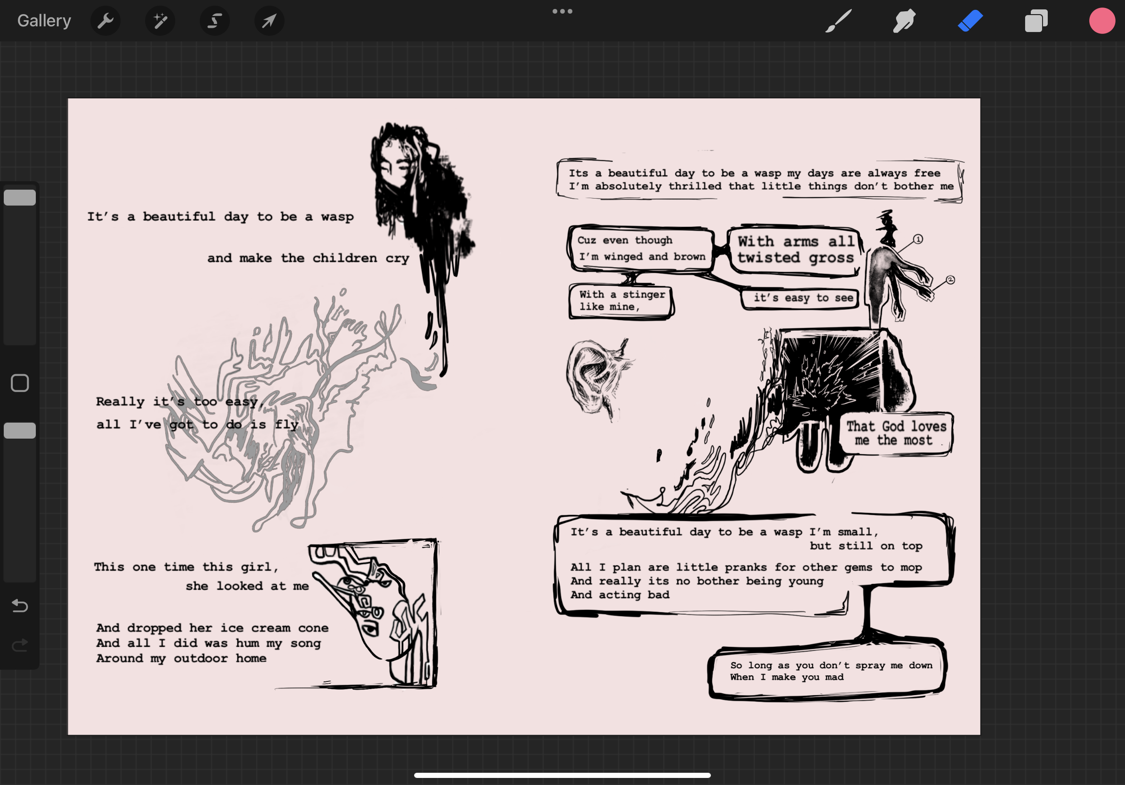

Slide 19
Notes:
Gift-giving rather than art

Slide 20
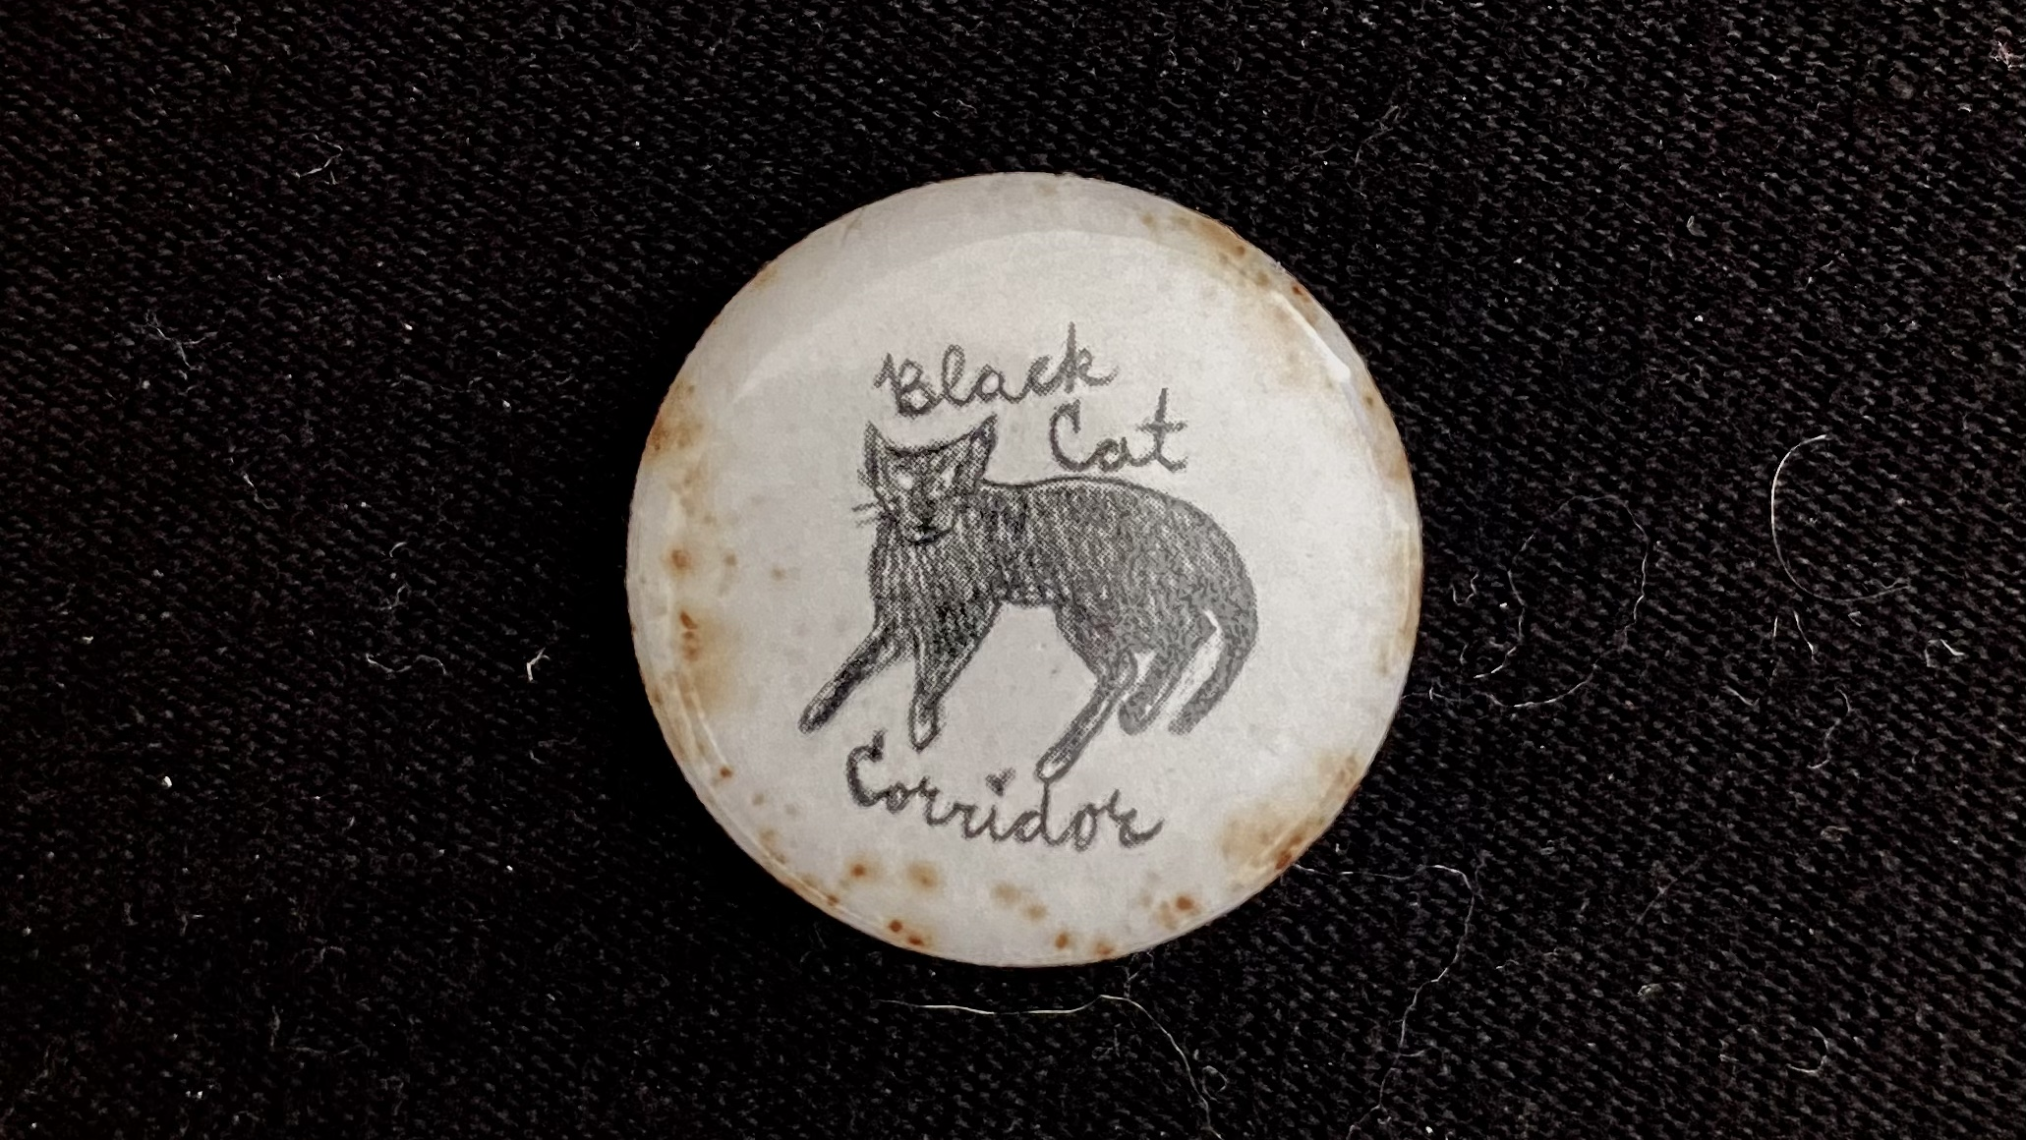
IS IT ART OR ANTI-ART?
Notes:
IS art a precious thing that should be attributed to artists?
If it’s reproducible and anonymized, is it still art?

